Slide 1

Introduction to Microsoft Office (Part 2 Microsoft PowerPoint)
Lab No:4
Name MUHAMMAD SADEEQ
Section C
Roll Number 75025
Submitted to Abdullah Hamid

Slide 2
HOW TO INSTALL WINDOWS 10
STEP TO INSTALL WINDOW 10
CHECK YOUR DEVICE MEETS THE WINDOWS 10 SYSTEM REQUMENTS
CREATE USB INSTALLATION MEDIA
RUN THE INSTALLER TOOL
USE YOUR INSTALLATION MEDIA
CHANGE YOUR COMPUTER BOOT ORDER
RESTART YOUR DEVICE
COMPLETE THE INSTALLATION

Slide 3
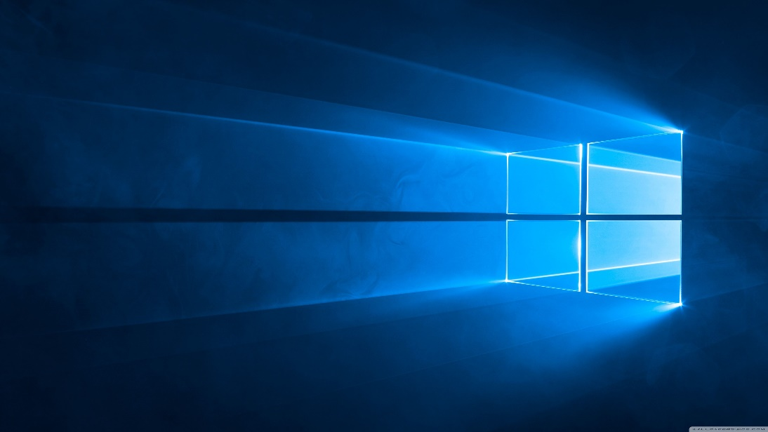
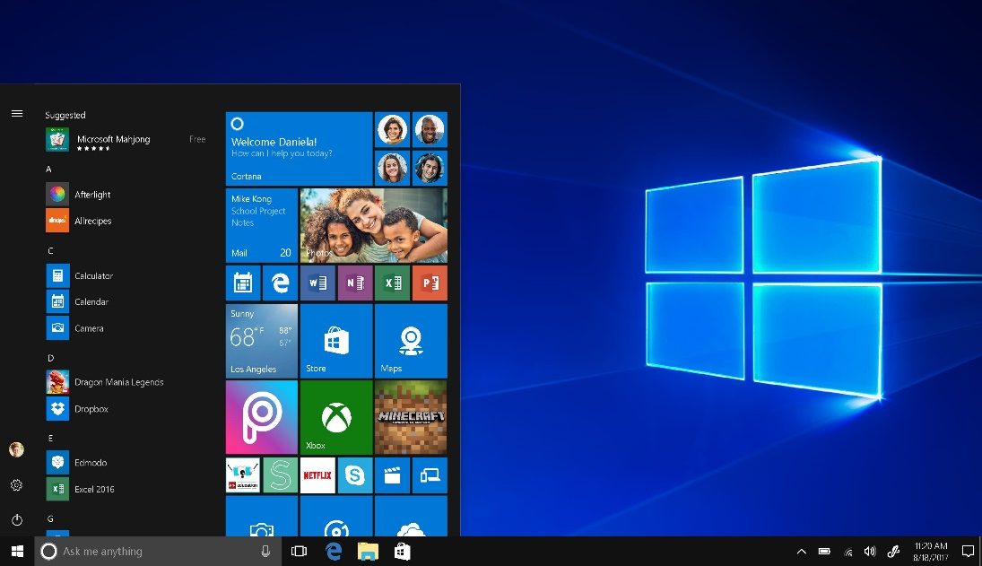
Now we will first be going to see the advantages: Ease to Use: The more modern ones are possibly simple for users familiar with previous versions as well. Plug & Play: Windows is also a specialist in plug & play support for PC hardware, as an operating system for the average home user
It turns out, you can still upgrade to Windows 10 without spending a dime. It turns out there are several methods of upgrading from older versions of Windows (Windows 7, Windows 8, Windows 8.1) to Windows 10 Home without paying the $139 fee for the latest operating system.

Slide 4

Window 10 advertisement

